Slide 1
Deep Learning Assignment 1
S10223485H – Tran Huy Minh
Presentation Link: https://youtu.be/DVfHyH3IbU4

Slide 2
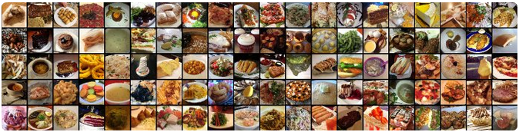
1. Overview
Build an image classification model to recognize and classify 10 types of food
Develop at least two models for the classification task, one trained from scratch and one using pre-trained models
The best model will be used to classify additional food images downloaded from the internet.

Slide 3
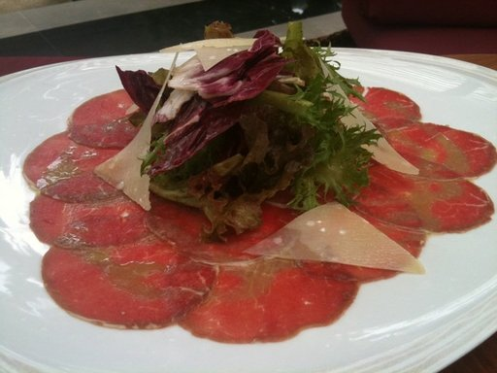
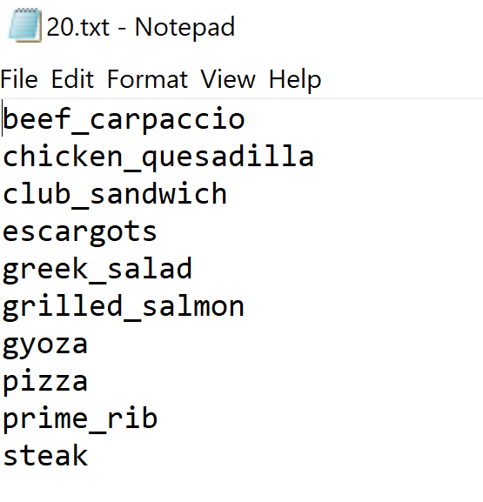
2. Data Preprocessing and Data Loading
Assigned foods from text file

Slide 4
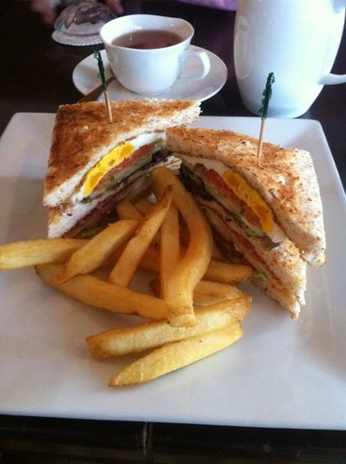
2. Data Preprocessing and Data Loading
Provided Image_Preprocessing notebook
Extracts images from dataset downloaded form Kaggle
Splits them into training, validation and testing folders
7500, 2000, 500 split

Slide 5

3. Develop the Image Classification Models
To build and train the models
The model's performance was analyzed during training to identify trends or patterns for improvement
Key metrics such as accuracy, loss, and convergence rate were tracked and performance was visualized through graphs and plots
The model's performance was regularly monitored to identify any issues and make adjustments to improve performance.

Slide 6
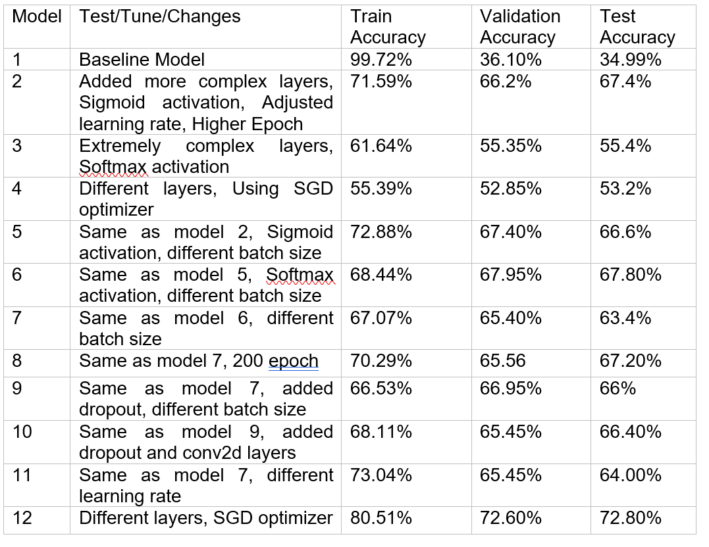
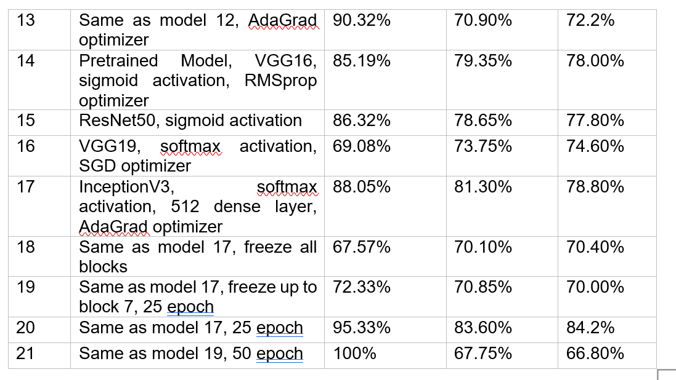
3. Model Table

Slide 7
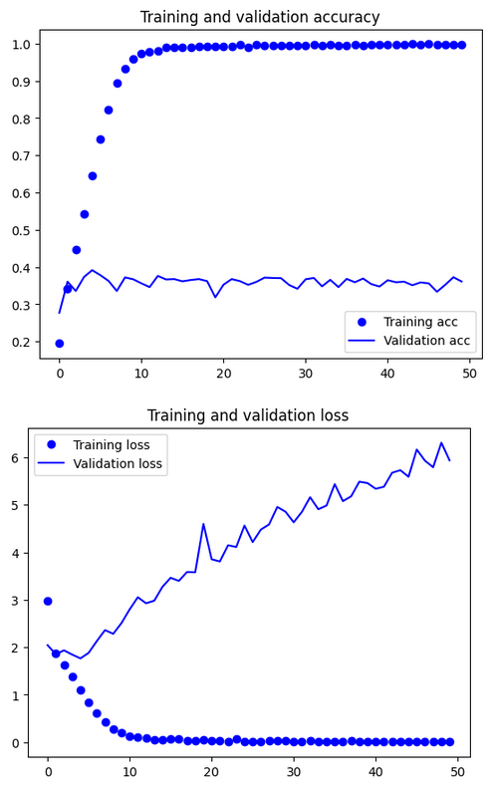
3. Develop the Image Classification Models
A baseline model is a simple model used as a benchmark to evaluate the performance of more complicated models
By using a baseline model, it is possible to determine if a more complex model is actually improving the performance of the model
Compare the performance of different models on a given task to determine which model is the best

Slide 8
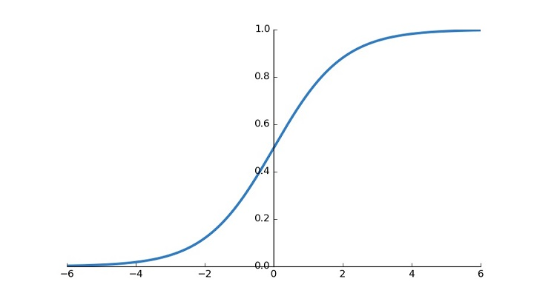
3. Develop the Image Classification Models
Softmax activation is commonly used for classification tasks with distinct categories
Sigmoid activation is often used for binary classification tasks with categories that are not mutually exclusive

Slide 9
3. Develop the Image Classification Models
Adagrad scales the learning rate of each parameter based on its past gradient updates
The learning rate for each parameter decays over time with Adagrad
Parameters that receive more updates have a smaller learning rate with Adagrad
RMSprop divides the learning rate by an exponentially decaying average of the squared gradients
This helps to prevent oscillation and divergence, especially when the learning rate is high with RMSprop
Stochastic gradient descent (SGD) is an optimization algorithm that updates the model parameters in the direction that minimizes the loss function
SGD is often used as a baseline for comparison with other optimization algorithms

Slide 10
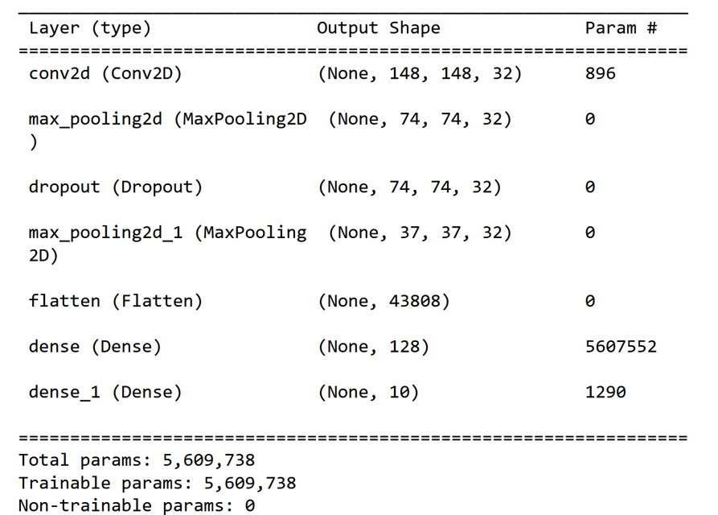
3. Notable Models – Model 2
Model 2 added complex layers and used sigmoid activation
RMSprop learning rate of 1e-4 and increased epochs to 150
Obtained 71.59% training accuracy, 66.20% validation accuracy, and 67.40% testing accuracy

Slide 11
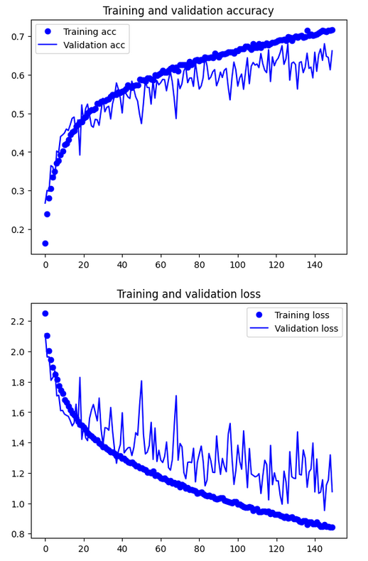
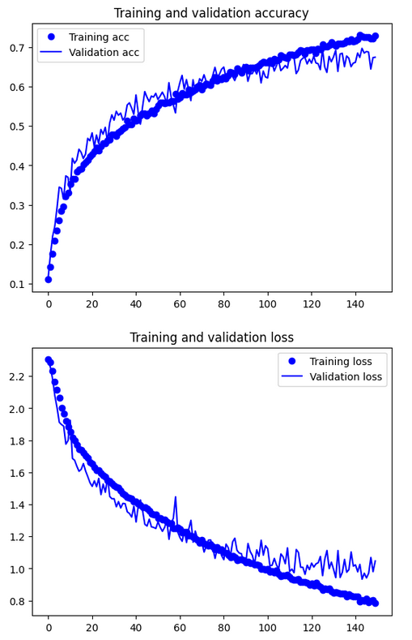
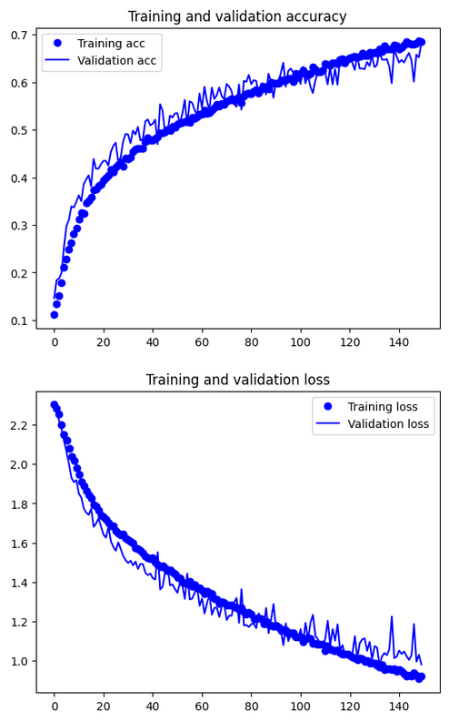
3. Notable Models – Model 2, 5, 6
Model 2
Model 5, softmax, diff batch size
Model 6, larger batch size

Slide 12
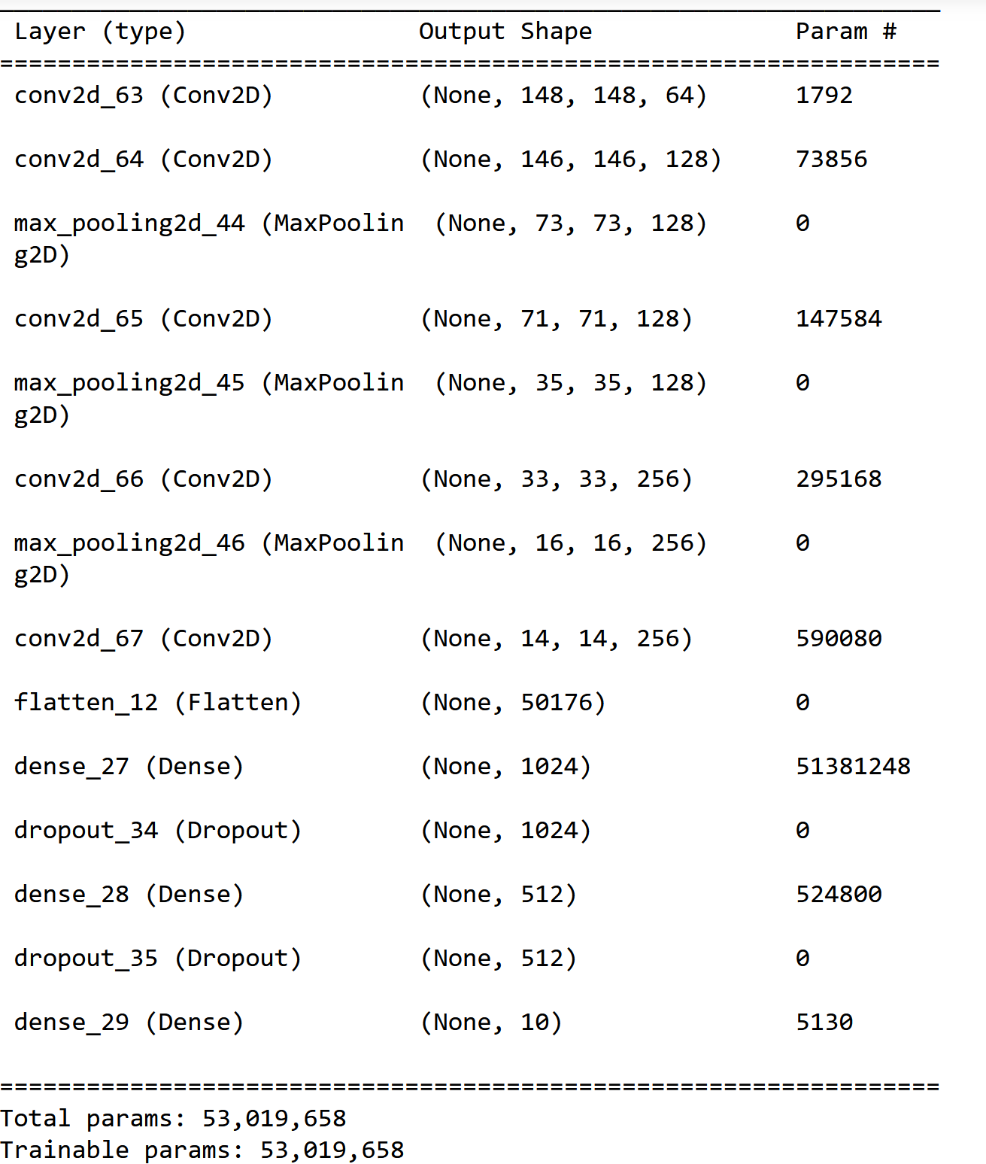
3. Notable Models – Model 12, 13
Model 12 uses SGD optimizer
Obtained 80.51% training accuracy, 72.60%% validation accuracy
Model 13 uses AdaGrad Optimizer
Obtained 90.32% training accuracy, 70.90% validation accuracy

Slide 13
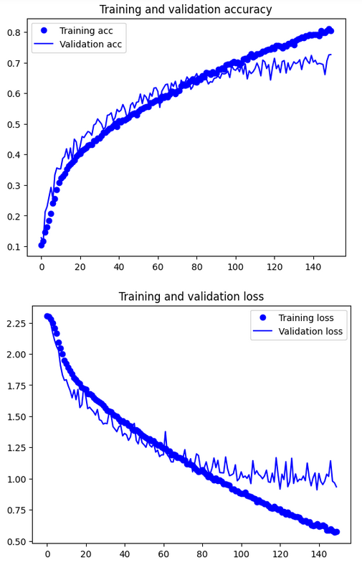
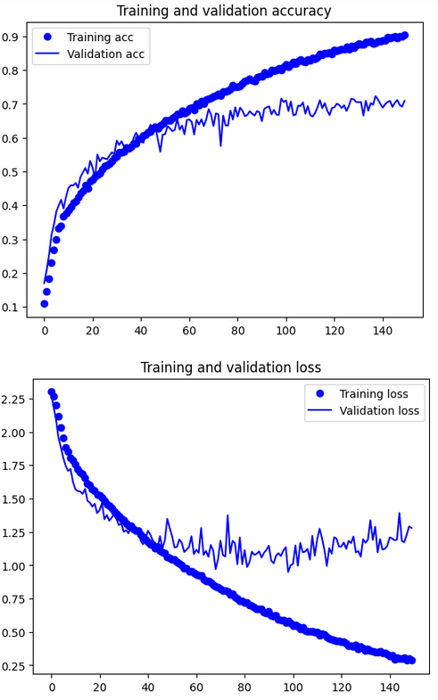
3. Notable Models – Model 12, 13
Model 12
Model 13

Slide 14
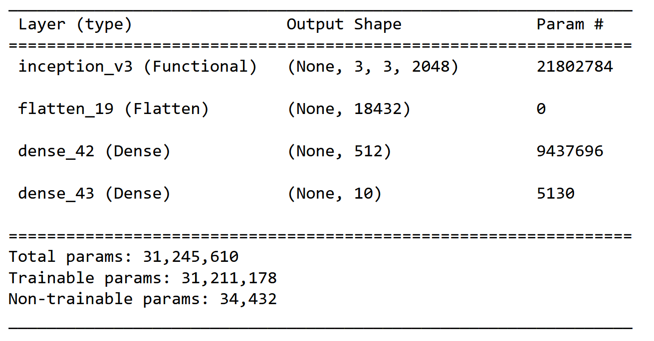
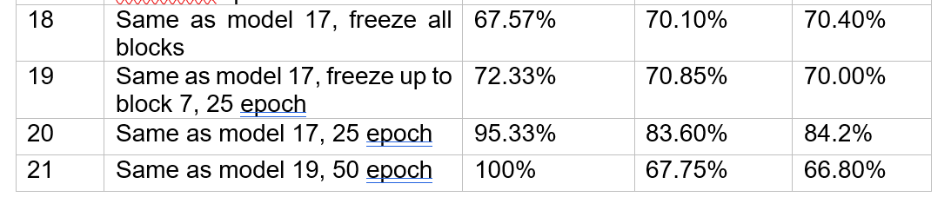
3. Notable Models – Model 18, 21, 20
Utilizes InceptionV3 as a pretrained model
Model 18 freezes all layers
Model 21 freezes up to the 7th out of 9 blocks, 50 epochs
Model 20 unfrozen layers, 25 epochs

Slide 15
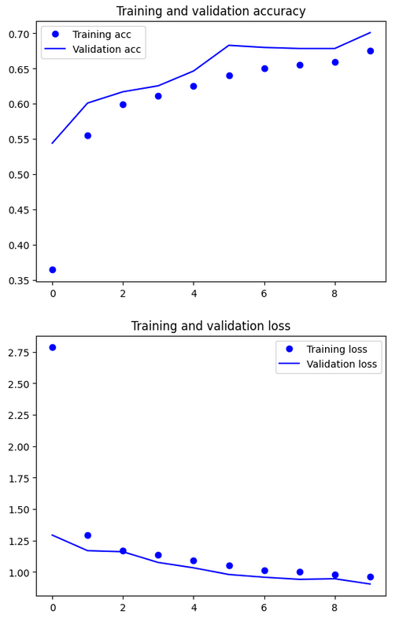
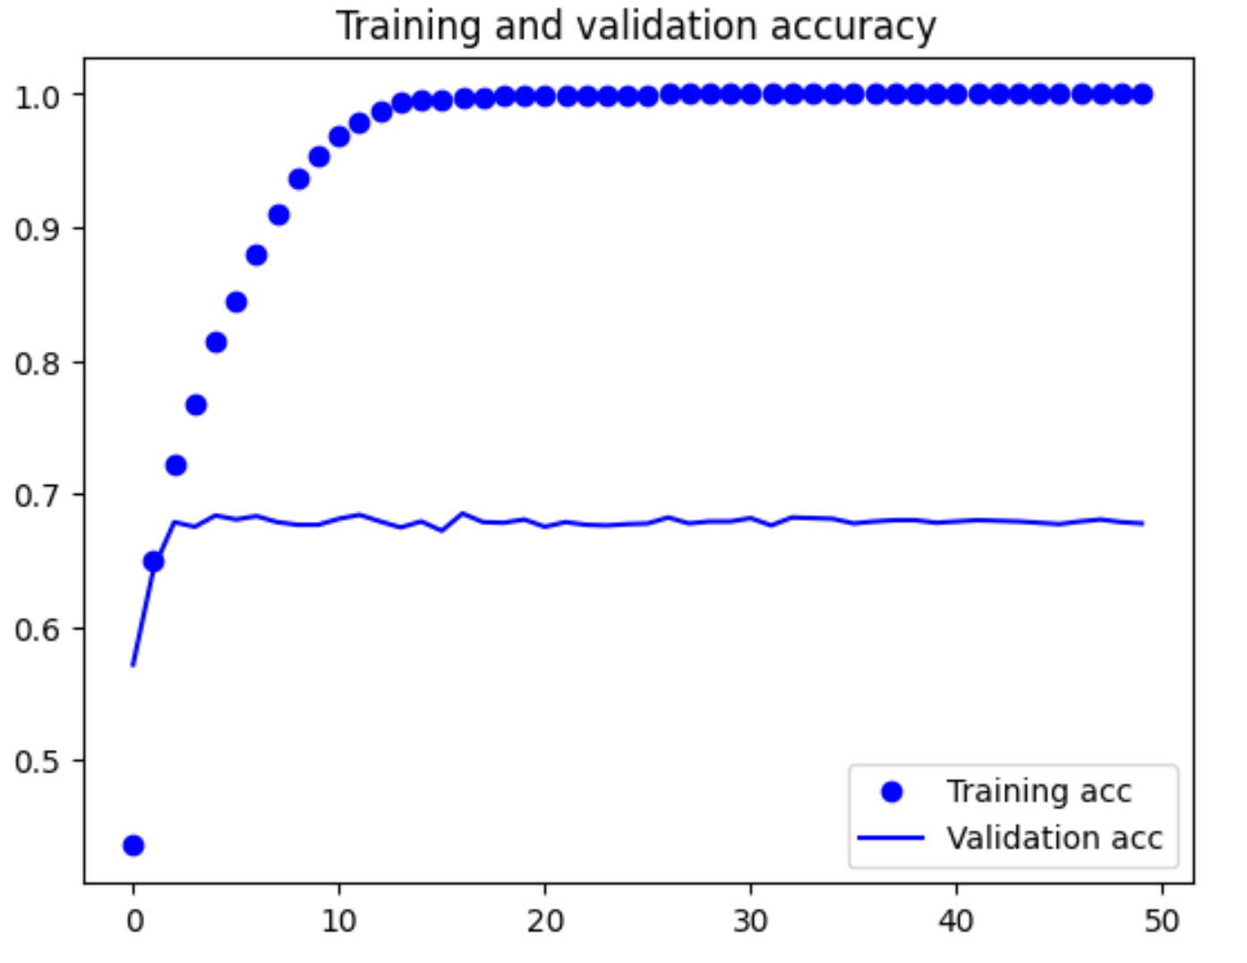
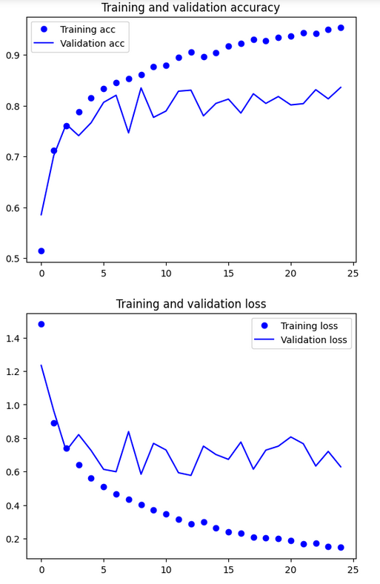
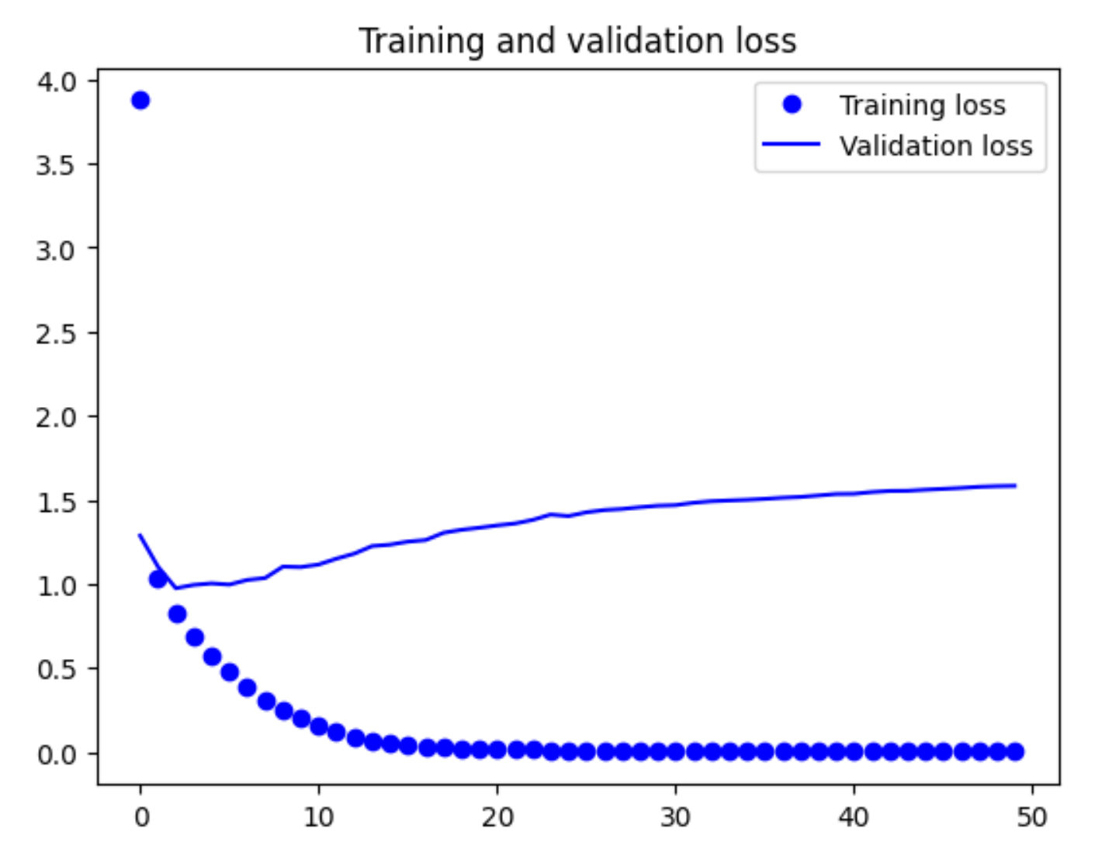
3. Notable Models – Model 18, 21, 20
Model 18
Model 21
Model 20

Slide 16
4. Evaluate models using Test images

Slide 17
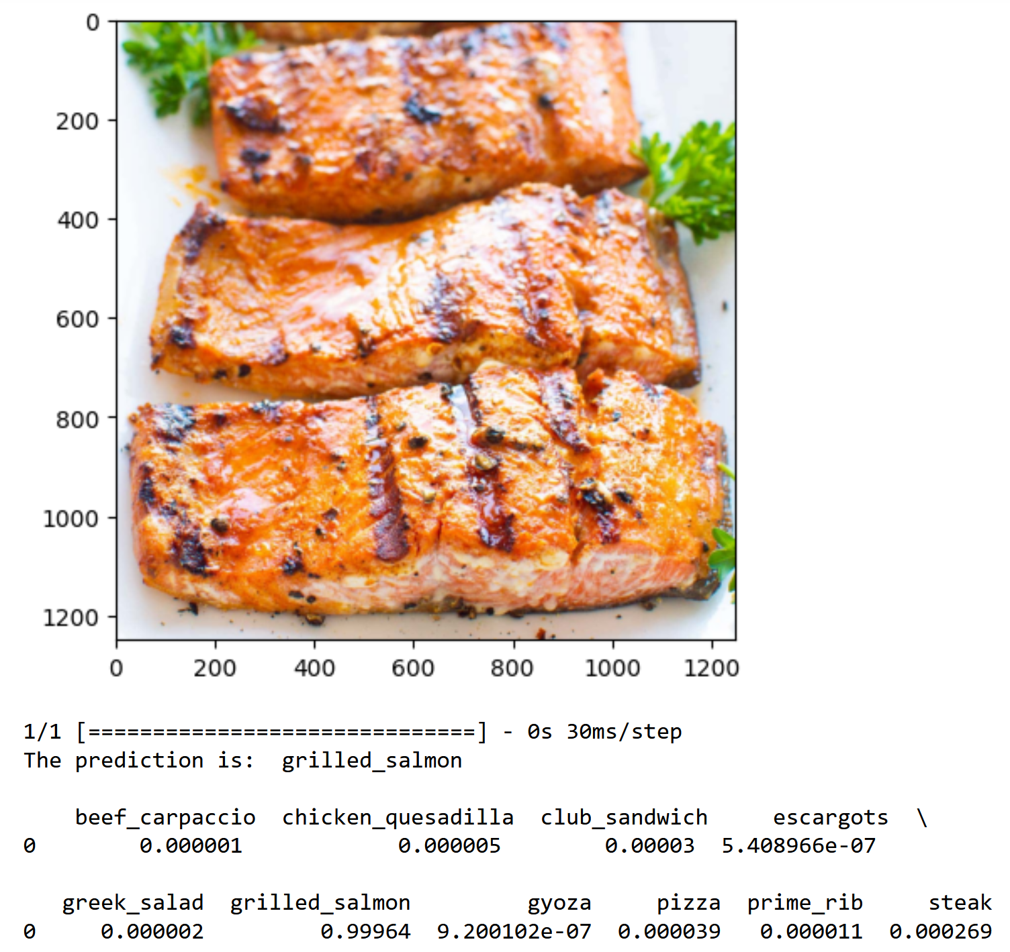
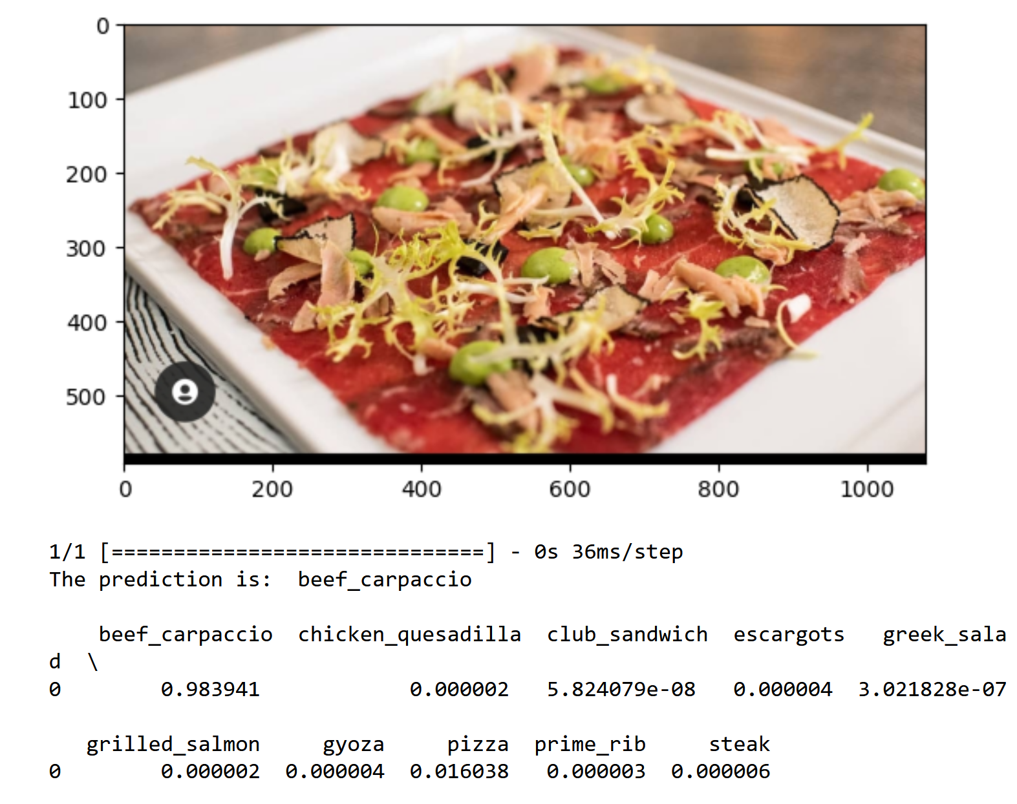
5. Use the Best Model to perform classification

Slide 18
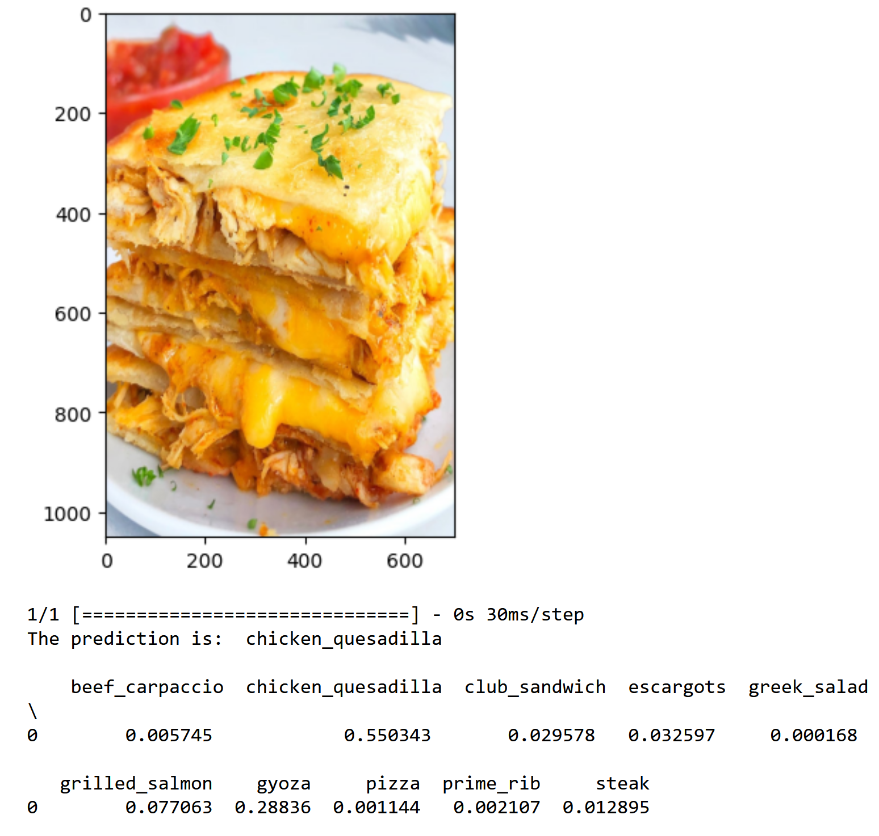
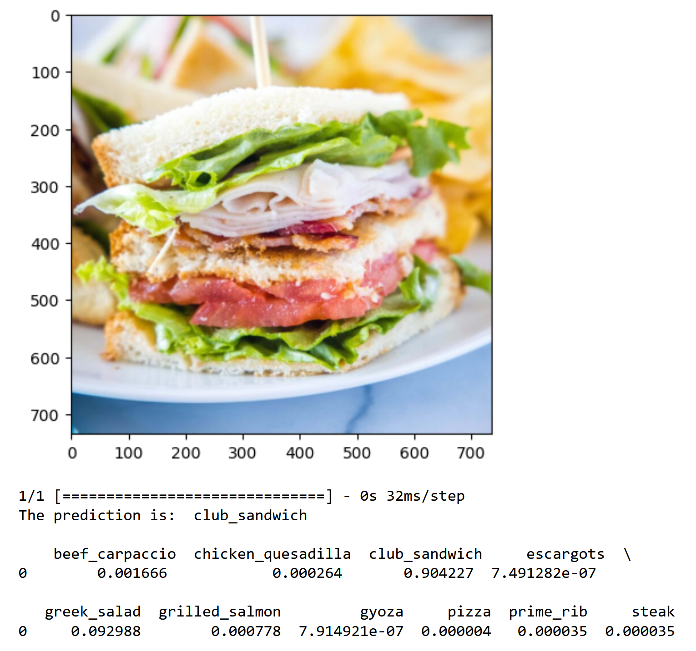
5. Use the Best Model to perform classification

Slide 19
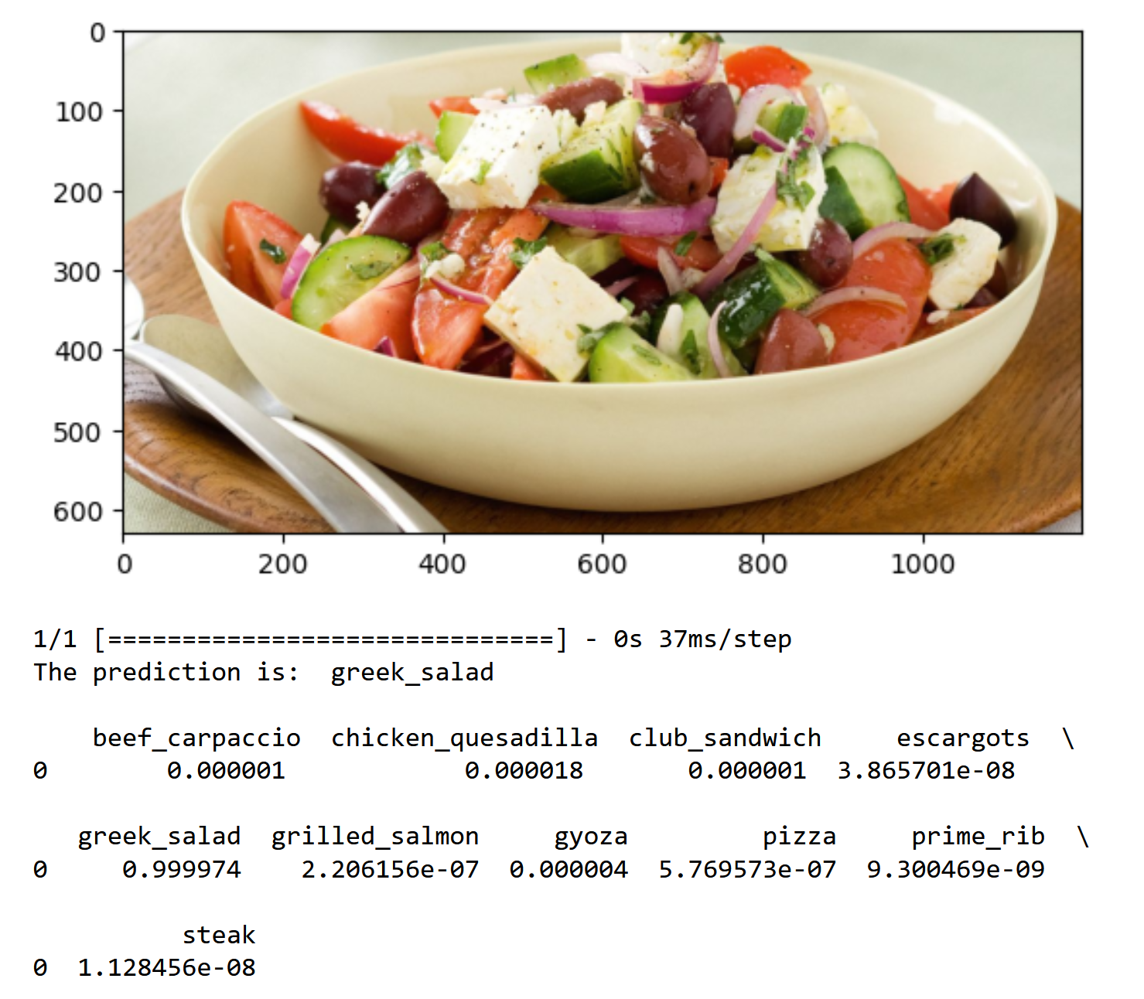
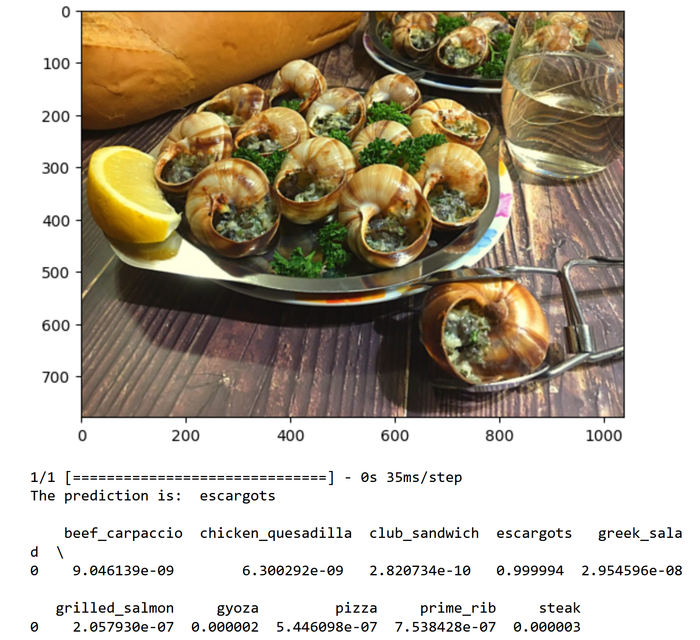
5. Use the Best Model to perform classification

Slide 20
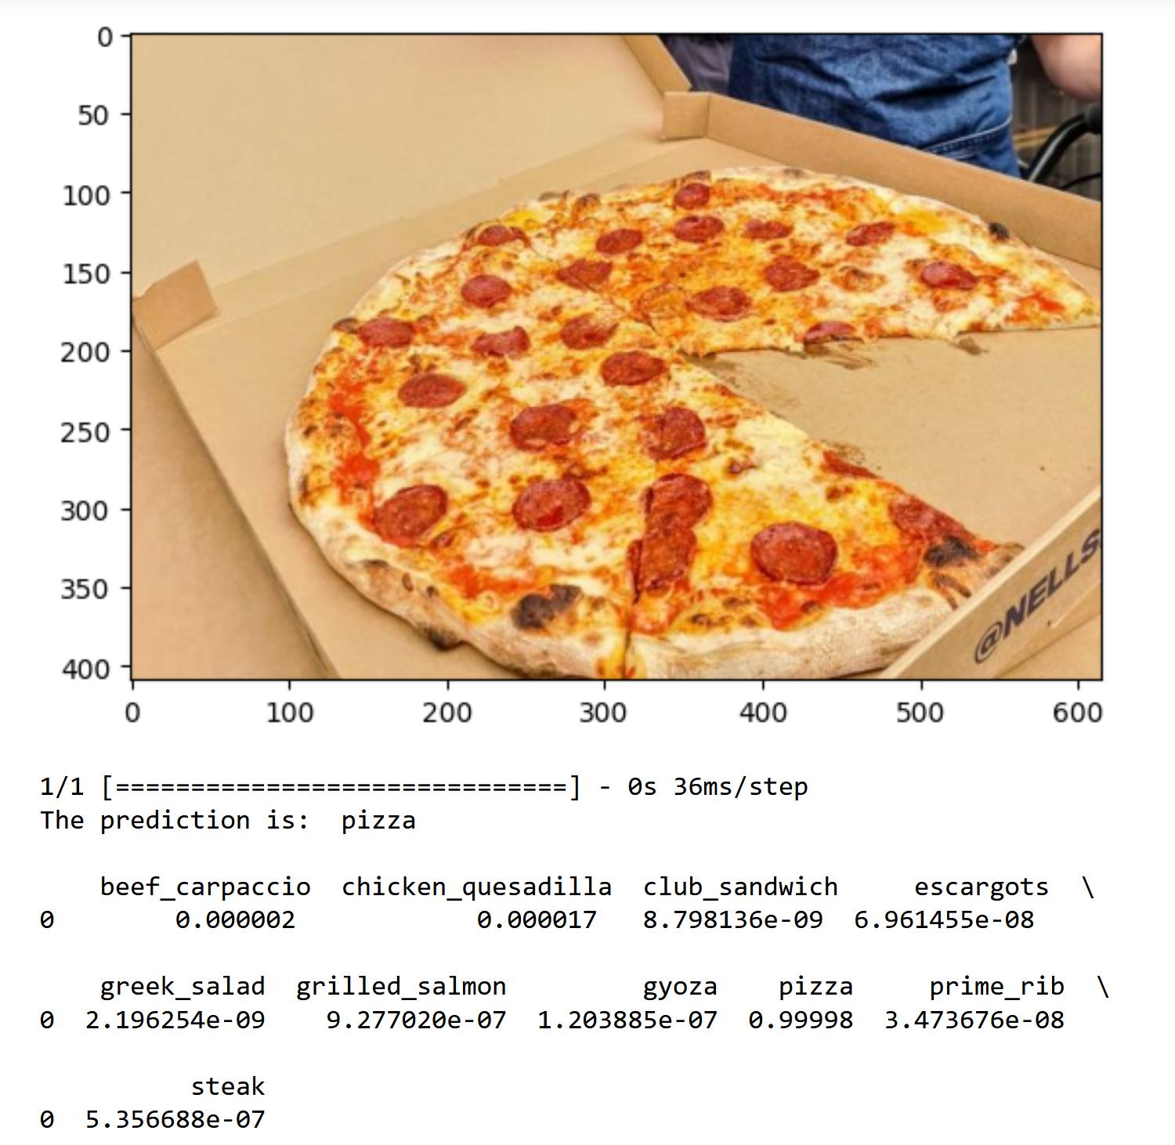
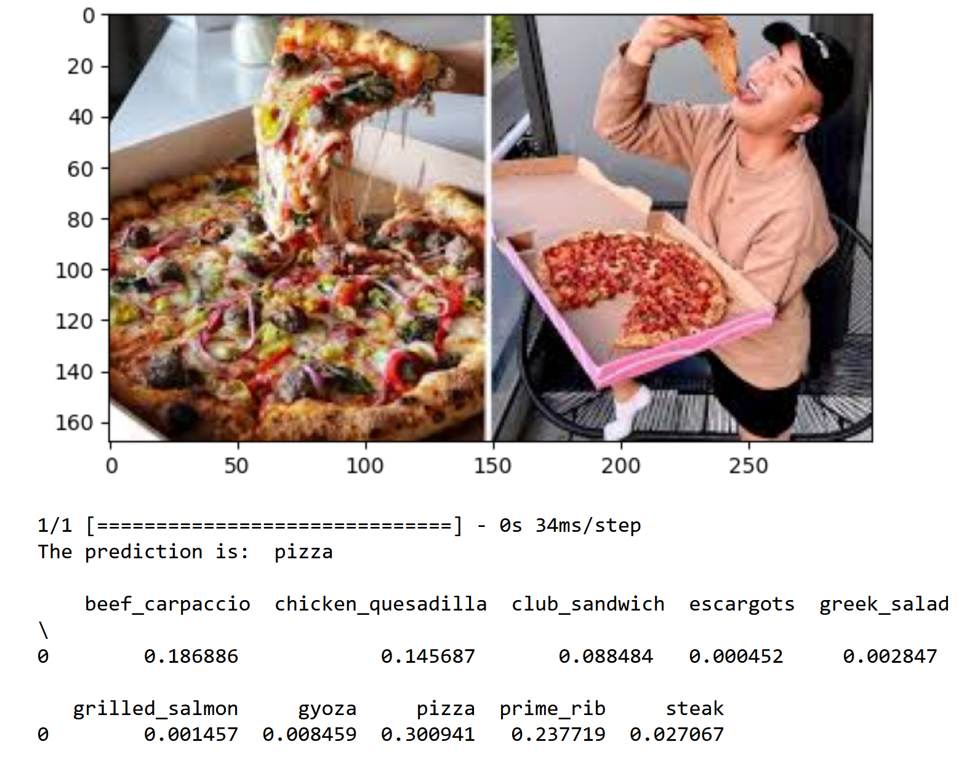
5. Use the Best Model to perform classification

Slide 21
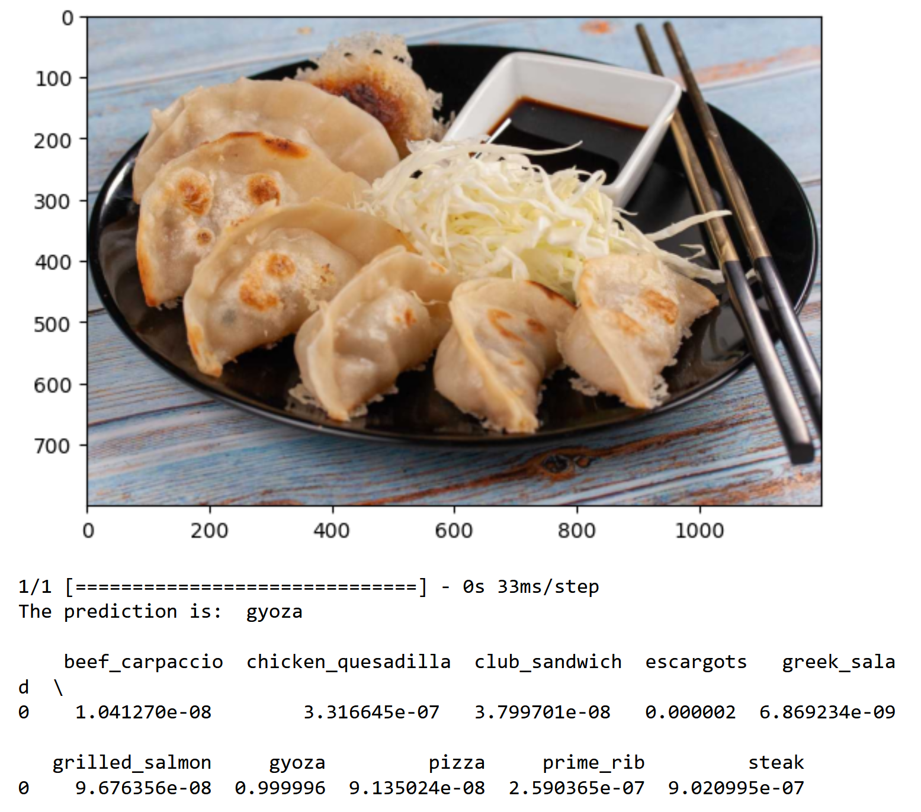
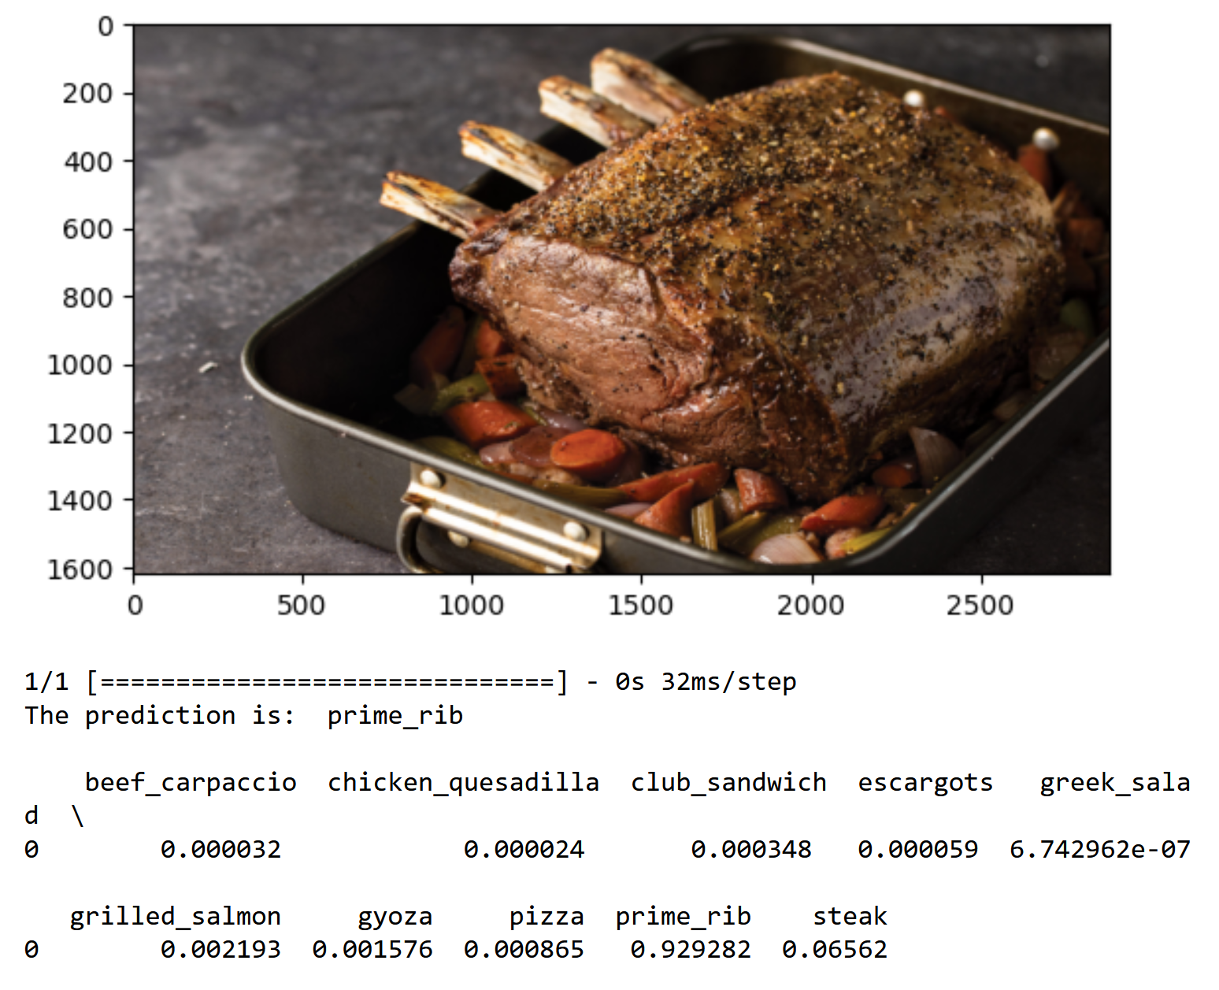
5. Use the Best Model to perform classification

Slide 22
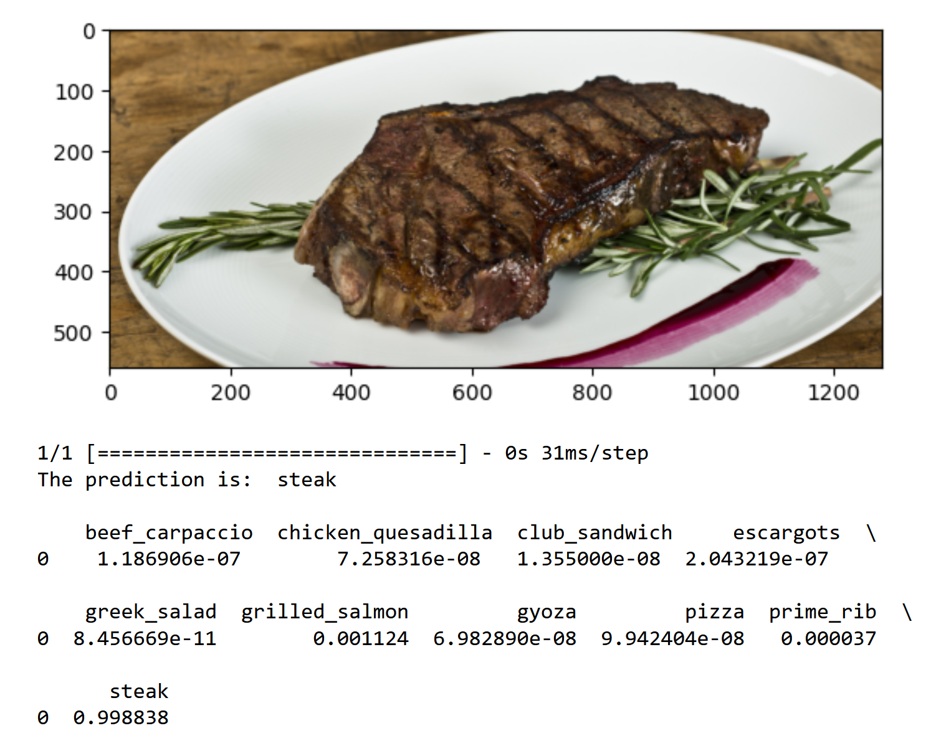
5. Use the Best Model to perform classification

Slide 23
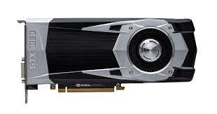
6. Summary/Further Improvements
Models were evaluated using test images and the best model was recommended based on performance
Final model achieved a test accuracy of 84.2%
Potential improvements include increasing number of epochs or changing hyperparameters until overfitting occurs
Additional notes:
NVIDIA GeForce GTX 1060 6GB
Intel Core i3-8100 CPU @ 3.60GHz

